Slide 1
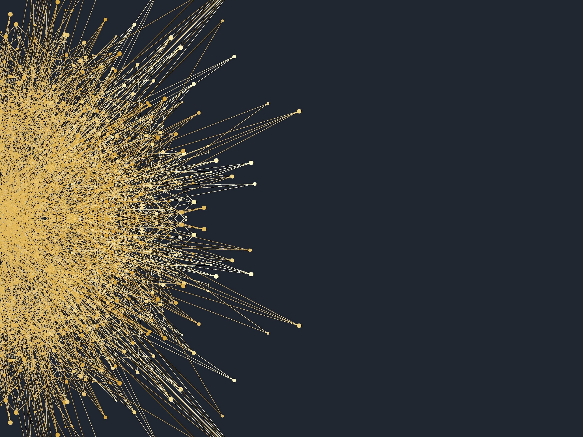
Computational Cognition and Deep Learning
By: Andy Malinsky
Mentor: Dr. Katherine Moore
Arcadia University

Slide 2
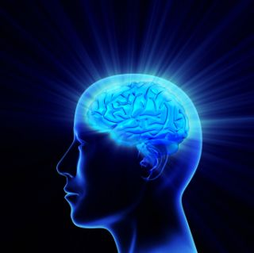
Intelligence Science
Vision
Reinforcement learning
Natural Language Understanding

Slide 3


99
The Neuron

Slide 4
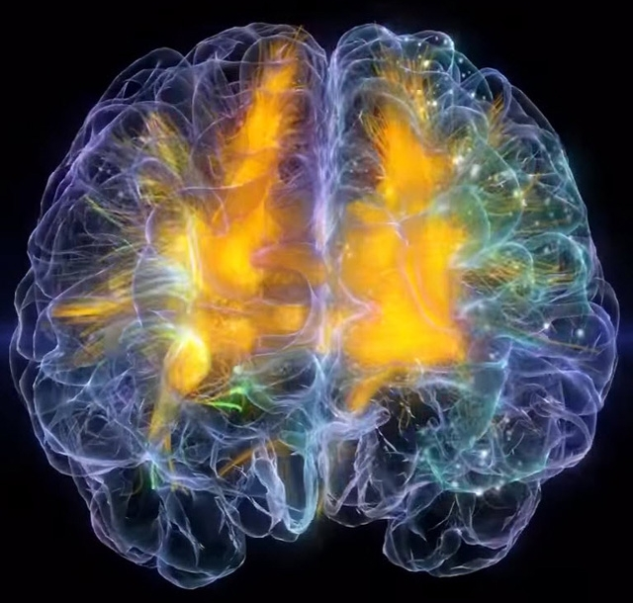
Computational Cognitive Neuroscience
Cognitive modeling
Connectionist approach
Artificial Neural Networks

Slide 5
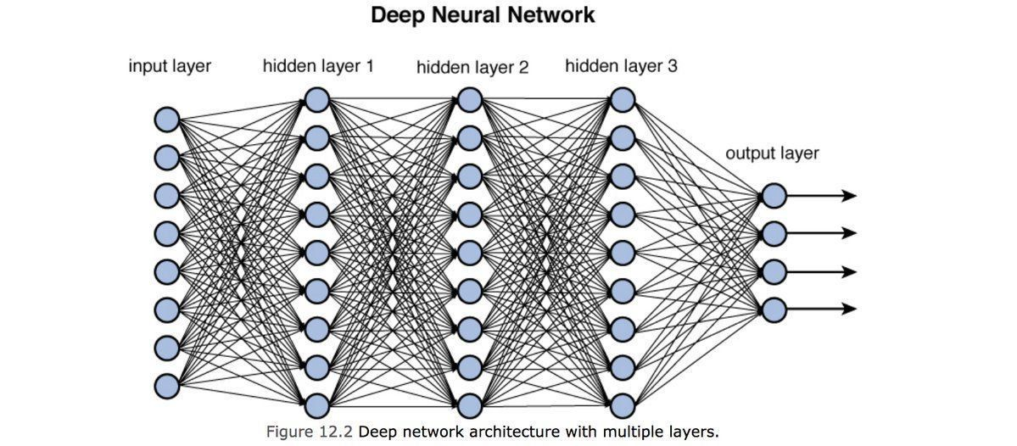
Deep Learning

Slide 6
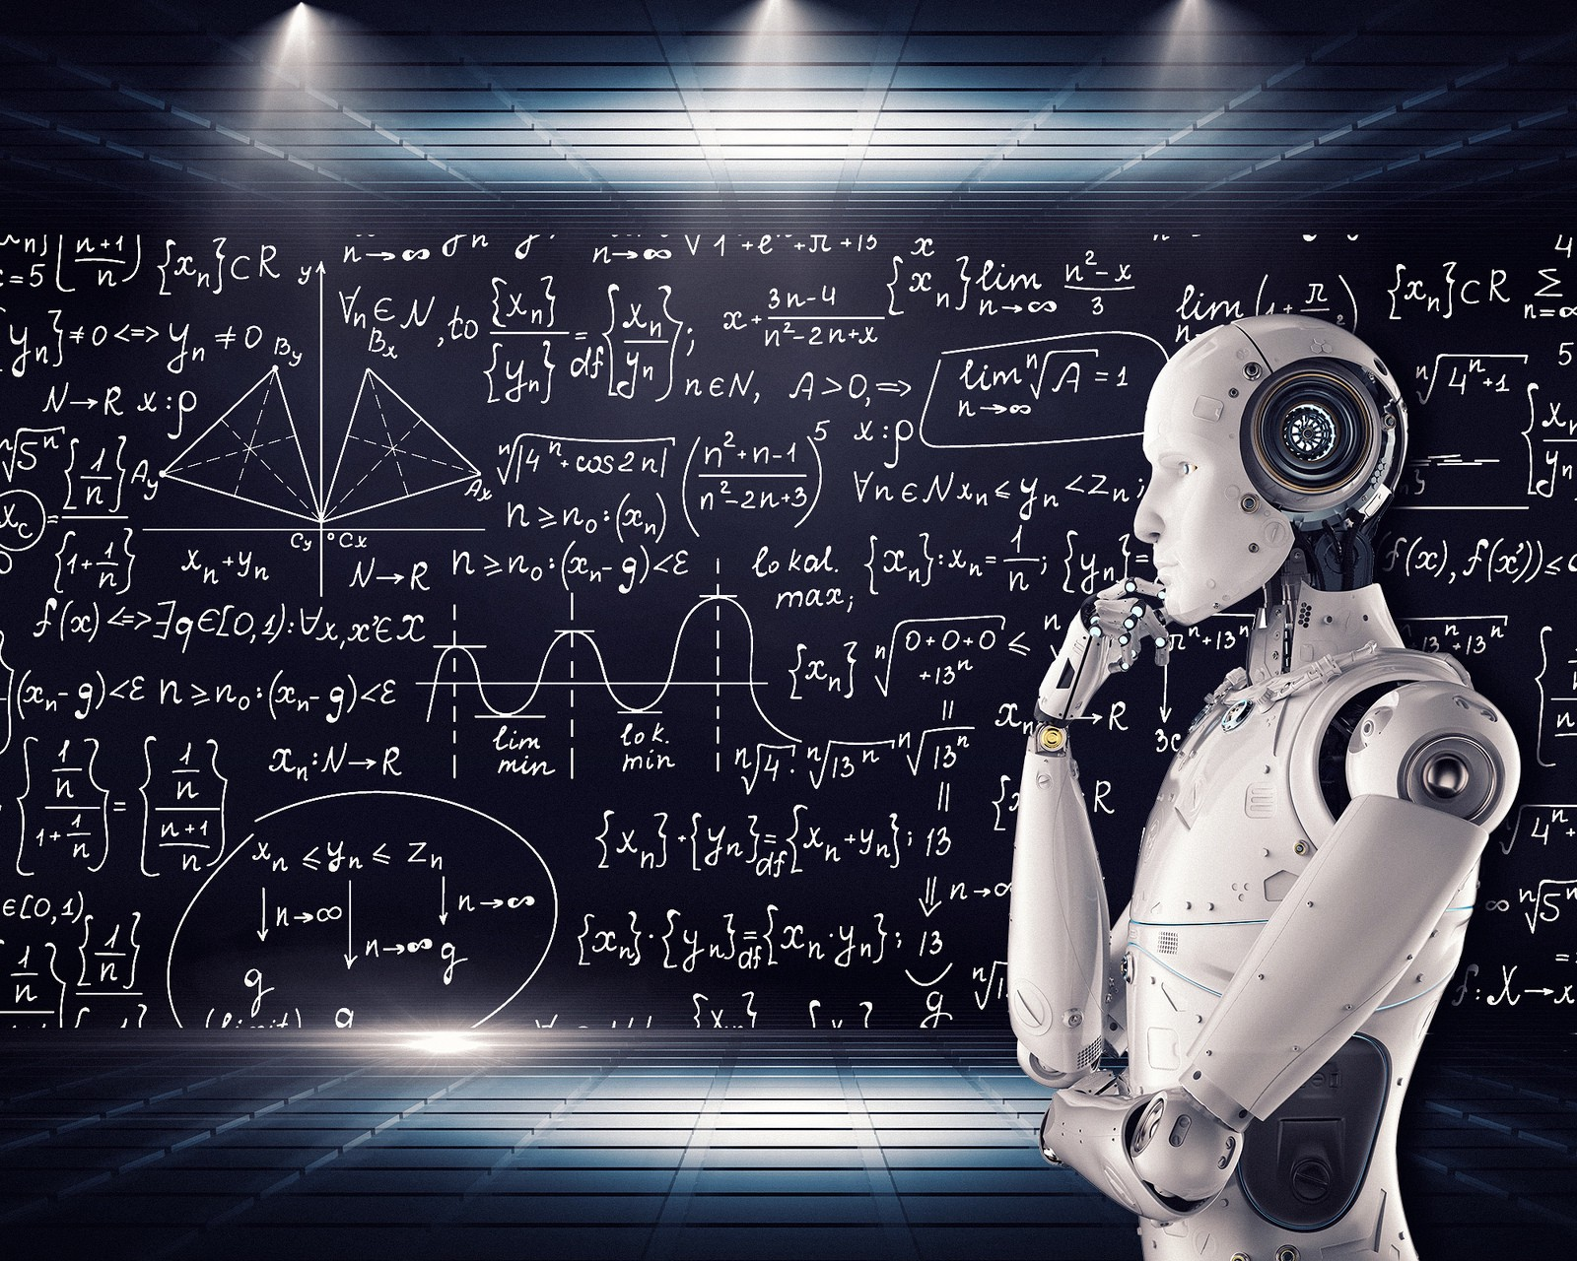
Artificial General Intelligence
Healthcare
Environment
Finance
Resource management

Slide 7
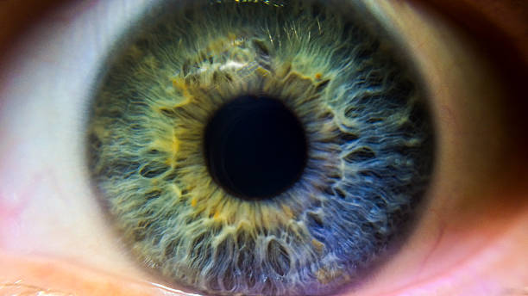
Vision
2D – 3D modeling
Primary visual cortex

Slide 8

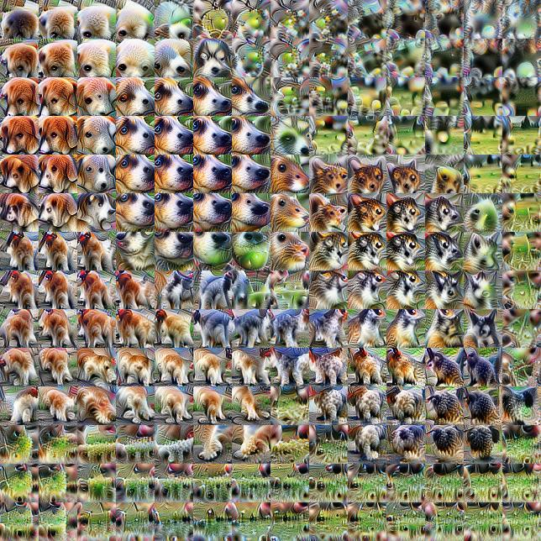

Convolutional Neural Networks

Slide 9

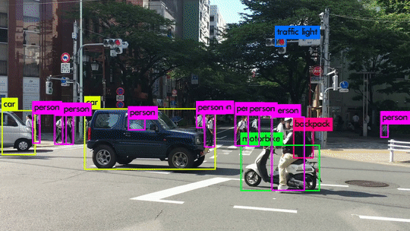
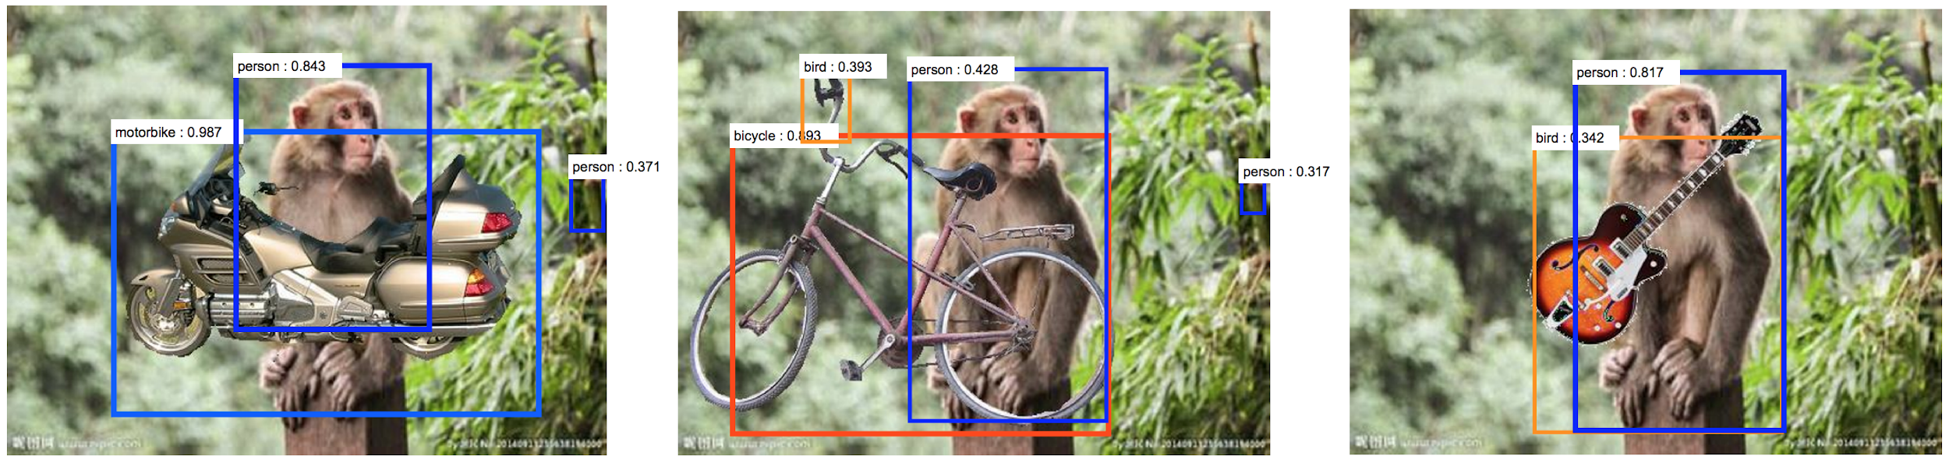
Limitations of Convolutional Neural Networks

Slide 10
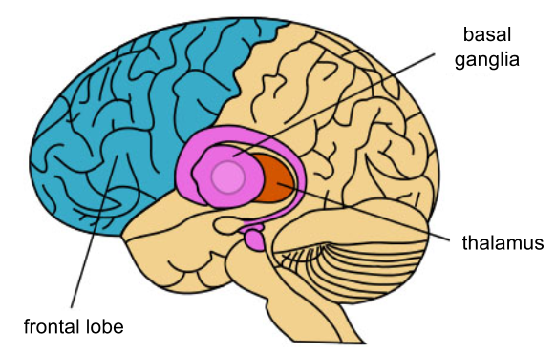
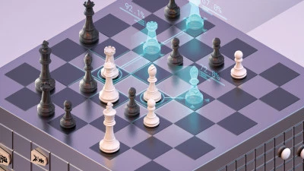
Reinforcement Learning

Slide 11
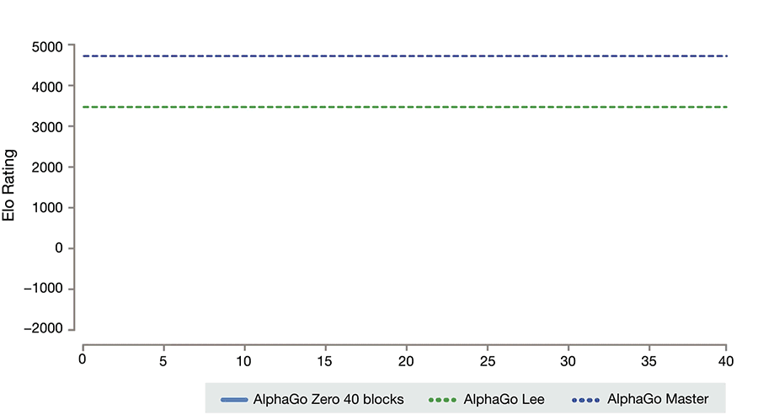
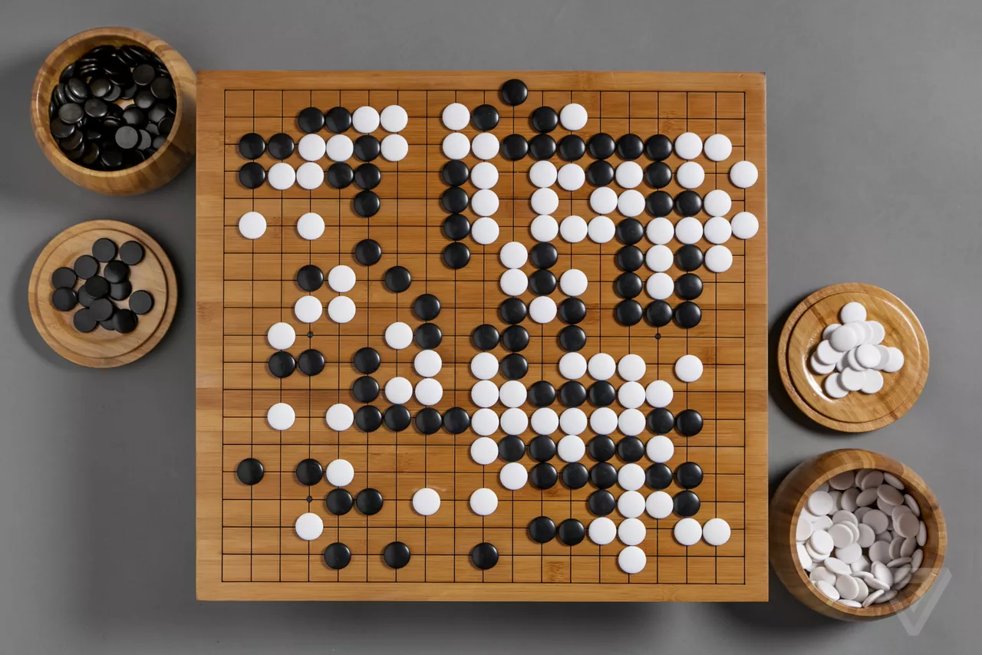
Reinforcement Learning

Slide 12
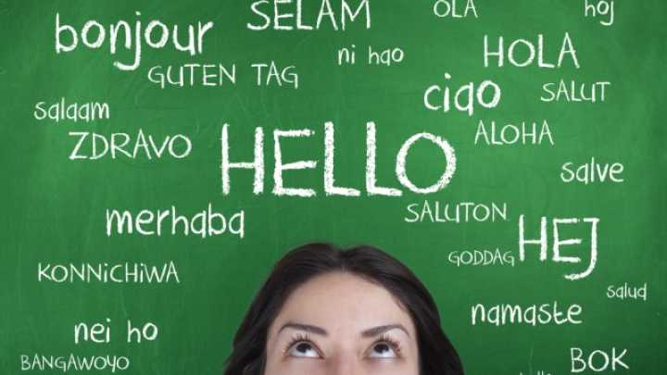
Natural Language Understanding
Semantic representation
Natural Language Processing (NLP)
Recurrent Neural Networks

Slide 13
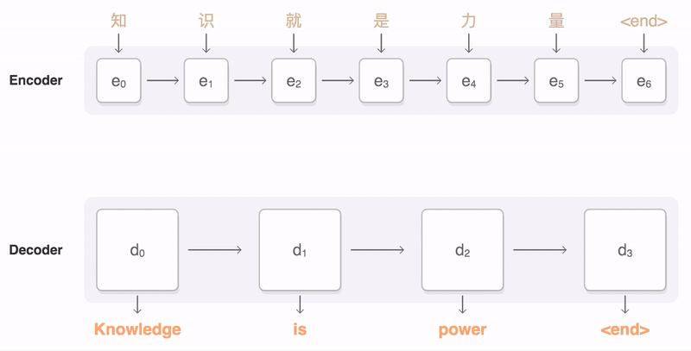
Neural Machine Translation

Slide 14
Spatial Invariance
I cnlduo't bvleiee taht I culod aulaclty uesdtannrd waht I was rdnaieg.
Unisg the icndeblire pweor of the hmuan mnid, aocdcrnig to rseecrah at
Cmabrigde Uinervtisy, it dseno't mttaer in waht oderr the lterets in a
wrod are, the olny irpoamtnt tihng is taht the frsit and lsat ltteer be in
the rhgit pclae. The rset can be a taotl mses and you can sitll raed it
whoutit a pboerlm. Tihs is bucseae the huamn mnid deos not raed ervey
ltteer by istlef, but the wrod as a wlohe. Aaznmig, huh?
(O’Reilly et al., 2012)

Slide 15
The Future

Slide 16
Bibliography
Cassimatis, N. L. (2012). Artificial intelligence and cognitive modeling have the same problem. In Theoretical Foundations of Artificial General Intelligence (pp. 11-24). Atlantis Press, Paris.
Goertzel, B. (2014). Artificial general intelligence: concept, state of the art, and future prospects. Journal of Artificial General Intelligence, 5(1), 1-48.
O'Reilly, R. C., Munakata, Y., Frank, M. J., Hazy, T. E., and Contributors (2012). Computational Cognitive Neuroscience. Wiki Book, 1st Edition. URL: http:/ / ccnbook. colorado. edu
Silver, D., Hubert, T., Schrittwieser, J., Antonoglou, I., Lai, M., Guez, A., ... & Lillicrap, T. (2017). Mastering chess and shogi by self-play with a general reinforcement learning algorithm. arXiv preprint arXiv:1712.01815.
Smolensky, P. (1987). Connectionist AI, symbolic AI, and the brain. Artificial Intelligence Review, 1(2), 95-109.
Ward, Jamie. The Student’s Guide to Cognitive Neuroscience. 3rd ed., Psychology Press, 2015. Print.

Slide 17
Image Links
https://deepmind.com/applied/deepmind-ethics-society/research/AI-worlds-complex-challenges/
https://www.sciencenews.org/blog/context/neuroscience-understanding-brain
https://thegradient.pub/the-limitations-of-visual-deep-learning-and-how-we-might-fix-them/
https://towardsdatascience.com/recurrent-neural-networks-the-powerhouse-of-language-modeling-d45acc50444f
https://distill.pub/2018/building-blocks/
https://medium.freecodecamp.org/an-intuitive-guide-to-convolutional-neural-networks-260c2de0a050
https://www.wired.com/2016/12/2016-year-deep-learning-took-internet/
https://syncedreview.com/2017/08/17/history-and-frontier-of-the-neural-machine-translation/
https://venturebeat.com/2018/12/06/google-deepmind-alphazero-chess-shogi-go/
https://kevinbinz.com/2016/01/17/basal-ganglia-introduction/
https://www.iflscience.com/technology/scientists-create-artificial-system-capable-learning-human-language/
https://www.re-work.co/blog/deep-learning-roland-memisevic-unlabelled-datasets-rethinking-unsupervised-learning
https://deepmind.com/blog/alphazero-shedding-new-light-grand-games-chess-shogi-and-go/
https://www.cyberailab.com/home/a-closer-look-at-yolov3
https://www.istockphoto.com/ca/photos/human-eye?sort=mostpopular&mediatype=photography&phrase=human%20eye
https://hackernoon.com/blockchain-artificial-general-intelligence-benefit-humanity-230e213cae12
https://towardsdatascience.com/training-deep-neural-networks-9fdb1964b964
http://web.eecs.utk.edu/courses/spring2017/cosc494/
https://www.psychologytoday.com/us/blog/high-octane-women/201201/the-power-the-mind-quotes-get-you-thinking
https://www.theverge.com/2016/3/8/11178462/google-deepmind-go-challenge-ai-vs-lee-sedol
https://deepmind.com/blog/alphago-zero-learning-scratch/

